Slide 1
RISC and CISC

Slide 2
RISC
RISC is the way to make hardware simpler whereas CISC is the single instruction that handles multiple work
Reduced Instruction Set Architecture (RISC)
The main idea behind this is to simplify hardware by using an instruction set composed of a few basic steps for loading, evaluating, and storing operations just like a load command will load data, a store command will store the data.

Slide 3
Characteristics of RISC
Simpler instruction, hence simple instruction decoding.
Instruction comes undersize of one word.
Instruction takes a single clock cycle to get executed.
More general-purpose registers.
Simple Addressing Modes.
Fewer Data types.
A pipeline can be achieved.

Slide 4
Advantages of RISC
Simpler instructions: RISC processors use a smaller set of simple instructions, which makes them easier to decode and execute quickly. This results in faster processing times.
Faster execution: Because RISC processors have a simpler instruction set, they can execute instructions faster than CISC processors.
Lower power consumption: RISC processors consume less power than CISC processors, making them ideal for portable devices.

Slide 5
Disadvantages of RISC
More instructions required: RISC processors require more instructions to perform complex tasks than CISC processors.
Increased memory usage: RISC processors require more memory to store the additional instructions needed to perform complex tasks.
Higher cost: Developing and manufacturing RISC processors can be more expensive than CISC processors.

Slide 6
Complex Instruction Set Architecture (CISC)
The main idea is that a single instruction will do all loading, evaluating, and storing operations just like a multiplication command will do stuff like loading data, evaluating, and storing it, hence it’s complex.

Slide 7
Characteristics of CISC
Complex instruction, hence complex instruction decoding.
Instructions are larger than one-word size.
Instruction may take more than a single clock cycle to get executed.
Less number of general-purpose registers as operations get performed in memory itself.
Complex Addressing Modes.
More Data types.

Slide 8
Advantages of CISC
Reduced code size: CISC processors use complex instructions that can perform multiple operations, reducing the amount of code needed to perform a task.
More memory efficient: Because CISC instructions are more complex, they require fewer instructions to perform complex tasks, which can result in more memory-efficient code.
Widely used: CISC processors have been in use for a longer time than RISC processors, so they have a larger user base and more available software.

Slide 9
Disadvantages of CISC
Slower execution: CISC processors take longer to execute instructions because they have more complex instructions and need more time to decode them.
More complex design: CISC processors have more complex instruction sets, which makes them more difficult to design and manufacture.
Higher power consumption: CISC processors consume more power than RISC processors because of their more complex instruction sets.

Slide 10
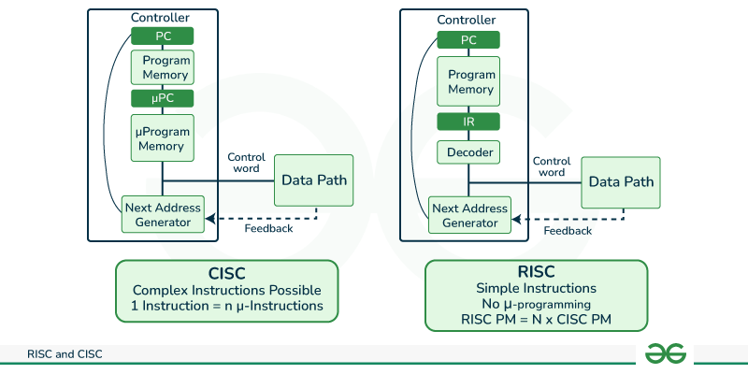

Slide 11

CPU Performance
Both approaches try to increase the CPU performance
RISC: Reduce the cycles per instruction at the cost of the number of instructions per program.
CISC: The CISC approach attempts to minimize the number of instructions per program but at the cost of an increase in the number of cycles per instruction.

Slide 12
Example:
Suppose we have to add two 8-bit numbers:
CISC approach: There will be a single command or instruction for this like ADD which will perform the task.
RISC approach: Here programmer will write the first load command to load data in registers then it will use a suitable operator and then it will store the result in the desired location.
So, add operation is divided into parts i.e. load, operate, store due to which RISC programs are longer and require more memory to get stored but require fewer transistors due to less complex command.

Slide 13
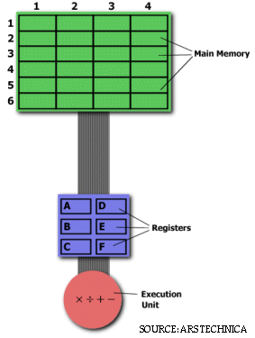
Multiplying Two Numbers in Memory Let's say we want to find the product of two numbers - one stored in location 2:3 and another stored in location 5:2 - and then store the product back in the location 2:3.

Slide 14
The CISC Approach MULT 2:3, 5:2
The RISC Approach
LOAD A, 2:3 LOAD B, 5:2 PROD A, B STORE 2:3, A

